Slide 1
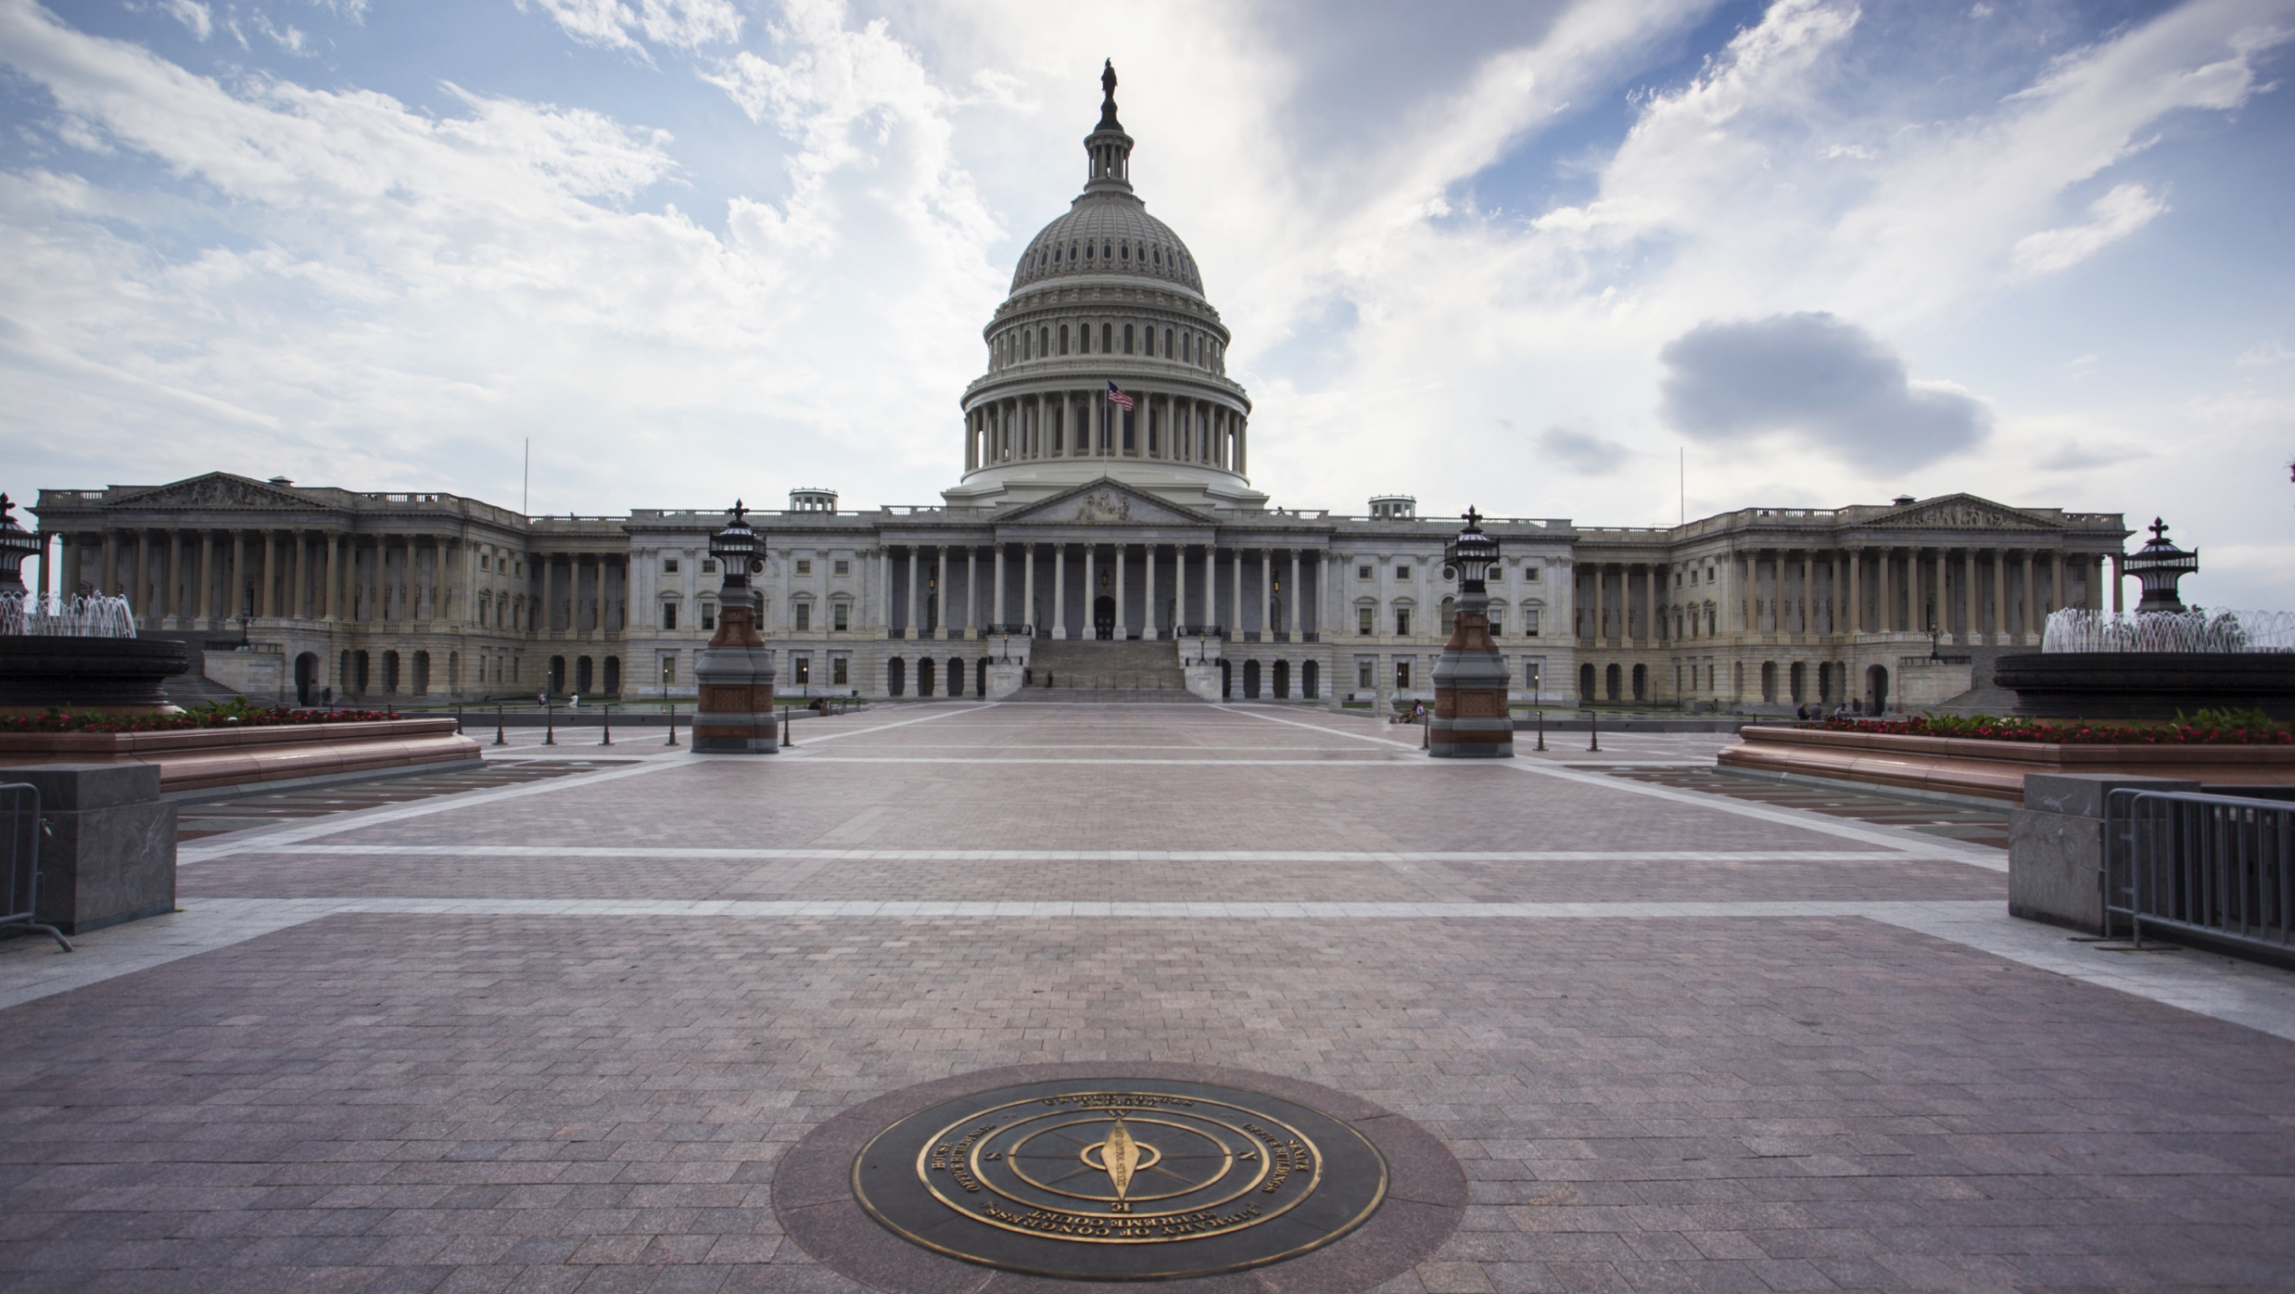
The Evidence-Based Policymaking Commission Act of 2016

Slide 2
The Basics
Creates a 15-member Commission to determine ways the federal government can “organize, protect, and analyze data to improve public policy.”
Sponsors: U.S. House Speaker Paul Ryan (R-WI) & U.S. Sen. Patty Murray (D-WA)
U.S. House passage
3/16/16
U.S. Senate passage
3/17/16
Presidential signing
3/30/16

Slide 3

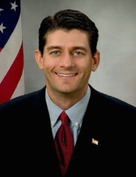
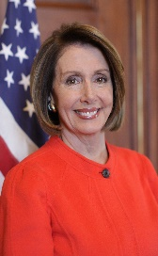
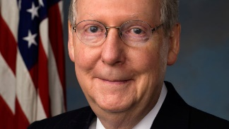
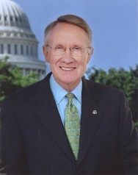
15 Member Commission
3 members appointed by the President
3 members appointed by the U.S. House Speaker
3 members appointed by the U.S. House Minority Speaker
3 members appointed by the U.S. Senate Majority Leader
3 members appointed by the U.S. Senate Minority Leader

Slide 4



Appointments President appoints 3 members:
1 academic researcher, data expert,
or expert in administering programs
1 expert in protecting personally-identifiable
information and data minimization
Director of OMB (or designee)

Slide 5
Appointments
U.S. House and Senate Majority and Minority Leaders each appoint 3 members:
2 must be an academic researcher, data expert, or expert in administering programs
1 must be an expert in protecting personally-identifiable information and data minimization

Slide 6
Members of the Commission
Dr. Katharine Abraham, Chair, University of Maryland
Ron Haskins, Co-Chair, The Brookings Institution
Dr. Sherry Glied, New York University
Dr. Robert Groves, Georgetown University
Dr. Robert Hahn, Georgetown University
Dr. Hilary Hoynes, University of California-Berkeley
Dr. Jeffrey Liebman, Harvard University
Dr. Bruce Meyer, University of Chicago
Paul Ohm, Georgetown Law Center
Allison Orris, White House Office of Management and Budget
Kathleen Rice, Faegre Baker Daniels LLP
Robert Shea, Grant Thornton LLP
Dr. Latanya Sweeney, Harvard University
Kenneth Troske, University of Kentucky
Kim Wallin, former Nevada State Controller

Slide 7



3 Duties of Commission
Study of Data
Study of Clearinghouse
Final Report

Slide 8
Study of Data
Study of data inventory, data infrastructure, database security, and statistical protocols related to Federal policymaking to
Determine best way to facilitate program evaluation, continuous improvement, policy-relevant research, and cost-benefit analyses
Recommend how data infrastructure, database security, and statistical protocols should be modified (to meet goals above)
Recommend how best to incorporate outcomes measurement, institutionalize randomized controlled trials, and rigorous impact analysis into program design

Slide 9
Study of Clearinghouse
The Commission shall consider whether and how to create a Clearinghouse of program and survey data
This study has 11 specific tasks, related to data access, data privacy, data sharing, etc.
For example: evaluating “how data and results of research can be used to inform program administrators and policymakers to improve program design”

Slide 10
Final Report
By September 2017 (15 months after majority of appointments) the Commission shall submit a report to the President and Congress that:
Includes findings and conclusions related to the data and clearinghouse study
Includes recommendations on legislation and administrative action
Requires approval by ¾ of Commission to submit

Slide 11










Executive Branch Assistance
The Head of each Agency Shall Advise and Consult
Census Bureau
Internal Revenue Service
U.S. Dept. of Health & Human Services
U.S. Dept. of Agriculture
U.S. Dept. of Housing & Urban Development
Social Security Administration
U.S. Dept. of Education
U.S Dept. of Justice
White House Office of Management and Budget
Bureau of Labor Statistics
Any other agency

Slide 12



The Commission
Meetings
Commission shall meet at least once and may meet more often, as the Chair/Co-Chair determine
Hearings
Commission may hold hearings, sit and act, take testimony, and receive evidence
Personnel
Commission must hire a Director, who may hire additional staff

Slide 13
Timeline
Bill signed
3/30/16
Appointments made
Commission meets
Report submitted
by Sep. 2017
Commission ends
by Nov. 2017
For more information: https://www.cep.gov

